Slide 1

Click It, No More Tick It: Using “Gimlet” Desk Statistics to Improve Services at the Charles W. Chesnutt Library
Velappan velappan, M.S., M.L.I.S.,
Head of access services
Fayetteville state university
North Carolina SerialS Conference 2017
March 31, 2017, Chapel Hill, NC

Slide 2
Introduction
Fayetteville State University is a constituent institution of the University of North Carolina and the second-oldest public institution of higher education in the state.
Founded in 1867 as the Howard School for the education of African-Americans.
Today FSU serves a growing student body of over 6,200 and ranks among the nation’s most diverse campus communities.
Charles W. Chesnutt Library’s Circulation & Reference Desk is open for 97.5 hours, on a regular week.

Slide 3

Gimlet
What is Gimlet?
Gimlet is a product of Sidecar Publications, LLC, from Madison, Wisconsin.
Gimlet is a very useful software to record the libraries’ desk statistics including questions and answers by creating new tags and put to their best use.
Website: http://gimlet.us/
URL for FSU Library:
https://charles-w-chesnutt-library.gimlet.us/users/login
COST: $20.00 per month for the first library branch
$10.00 per month for each additional branch

Slide 4

What did we use before Gimlet?
Paper and Pencil
Excel Spreadsheets

Slide 5
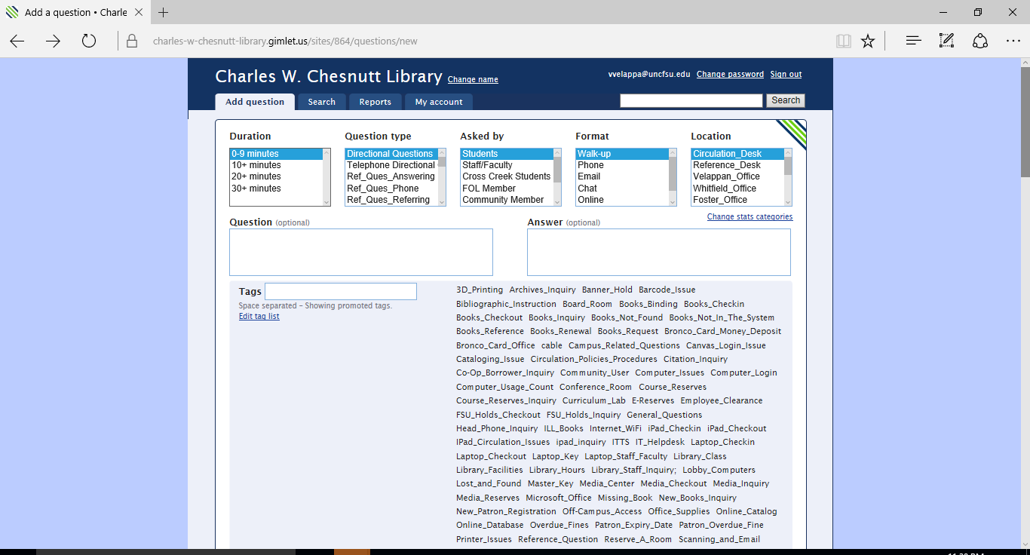
Our Library’s “Gimlet” Homepage

Slide 6
Simple Steps to follow when you use Gimlet
Step 1: Choose Appropriate Stats Categories
Step 2: Enter Question & Answer
Enter Question (Optional)
Step 3: Choose Correct Tag(s)
Choose appropriate Tag(s) from the list
Enter Answer (Optional)
Create a new Tag if you couldn’t find from the list
Duration
Question Type
Asked By
Format
Location

Slide 7
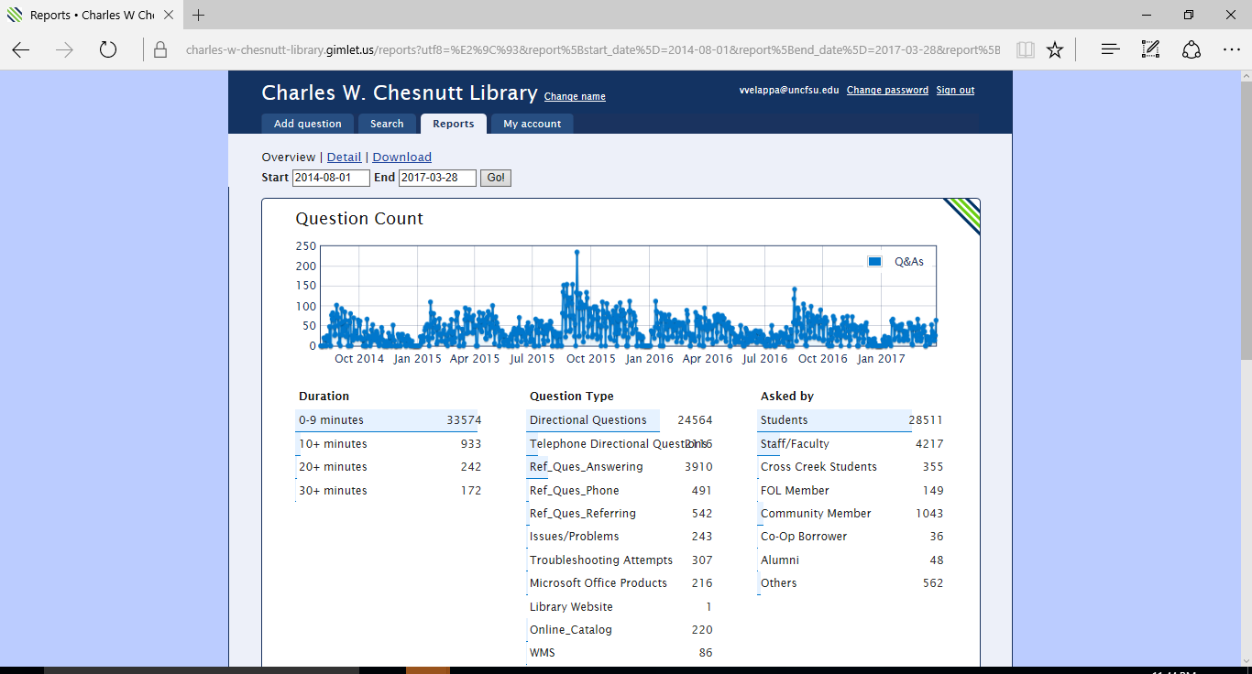
Gimlet Reports
Total number of questions answered – 35,398 for 2 years & 8 months since Aug. 6, 2014 - 1106 questions on average per month

Slide 8
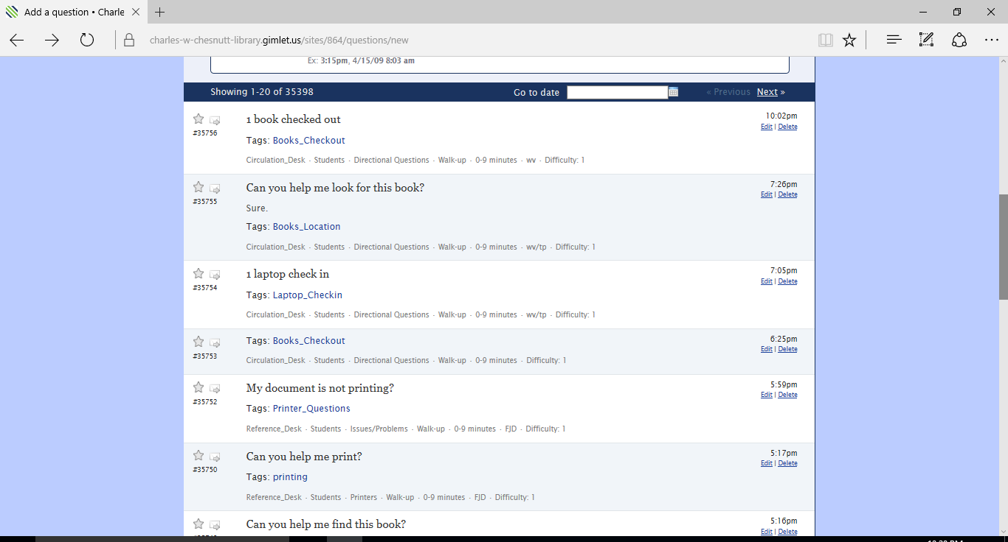
Sample Questions & Answers

Slide 9
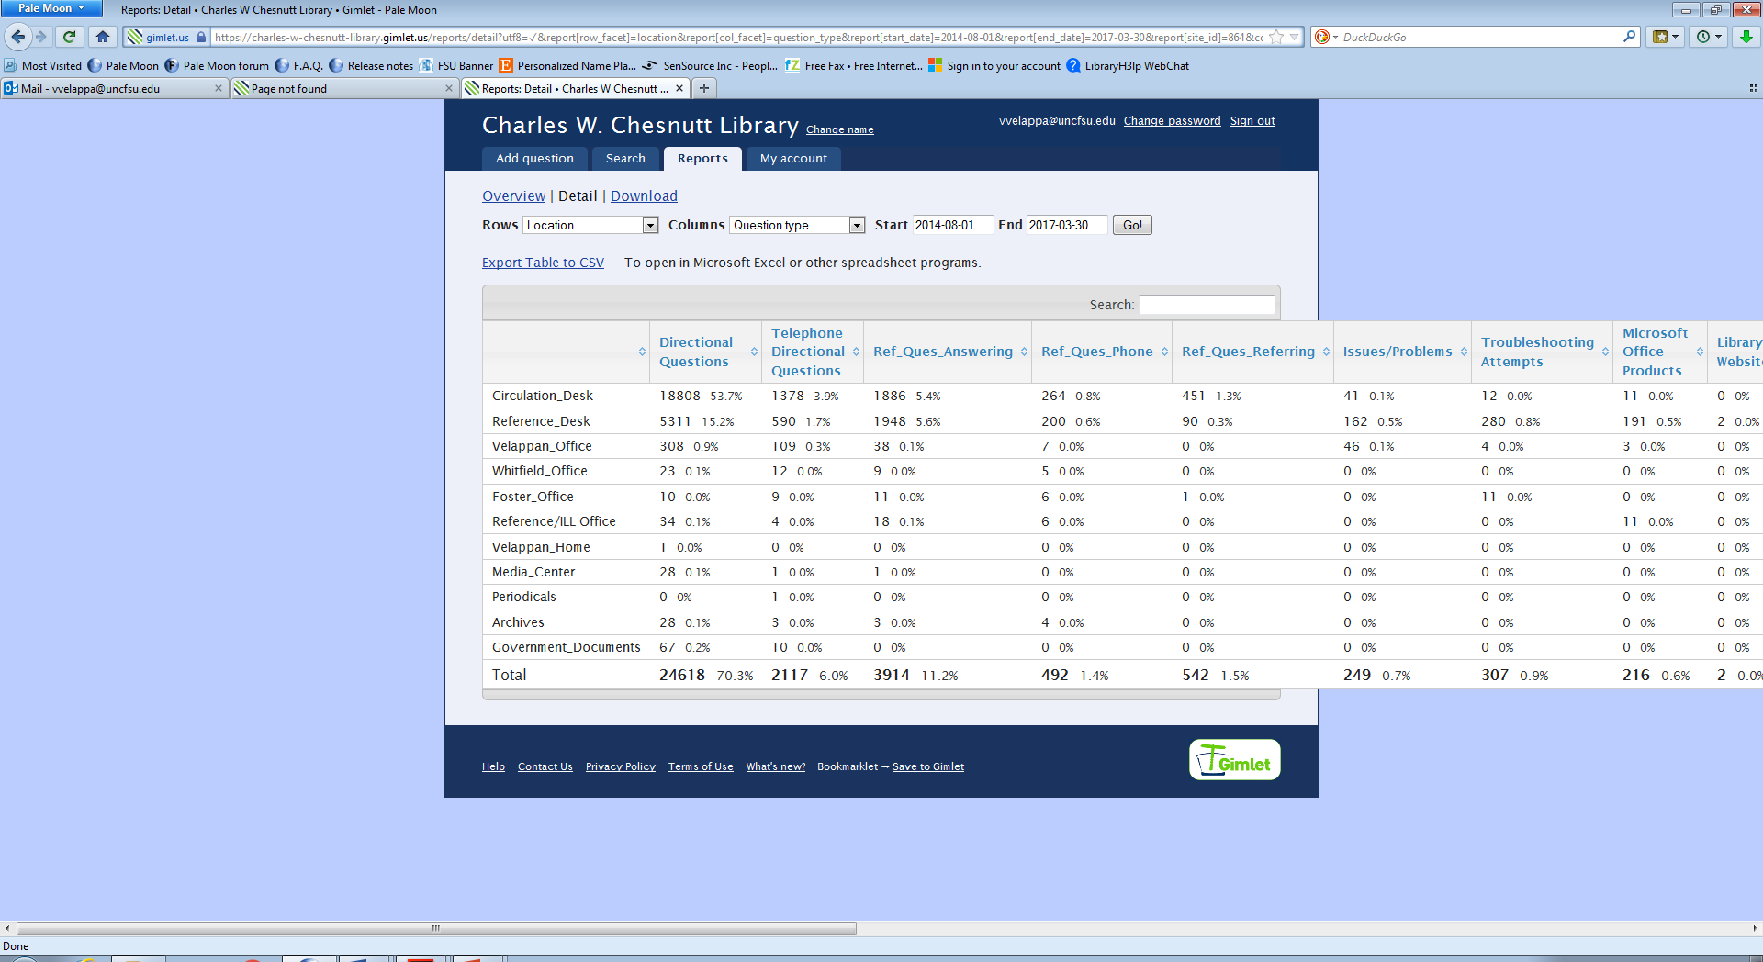
Detailed Report with Location & Question Type

Slide 10
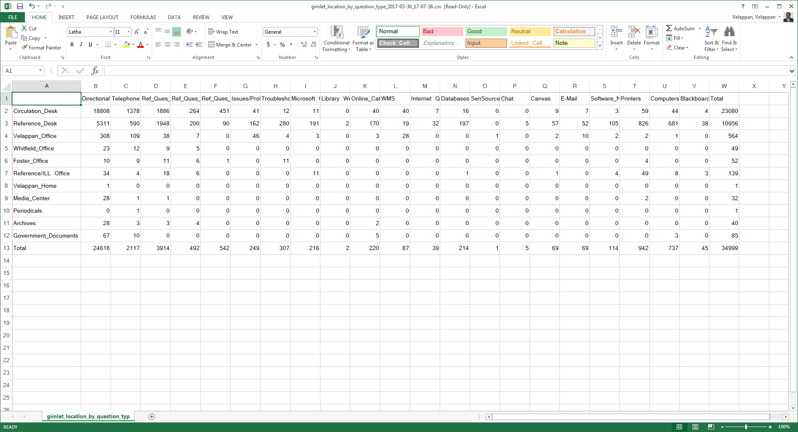
Table Exported to CSV

Slide 11
Special Features of Gimlet
Track Questions
Choose your category values - Customize your form to record what's important for you.
Record full-text of Q&As - The full-text is stored for search and retrieval.
Tag questions for quick answers - Tagging helps discover trends and patterns.
Search Answers
Full-text search with relevancy - Their intuitive search helps discover answers fast.
Find Q&As by text or tags - Search the entire question and answer text. Filters to find tagged Q&As.
Starred Q&As rise to the top - Starring helps you boost the best answers to the top of your result list every time.

Slide 12
Special Features of Gimlet (cont’d)
Build Reports
Charts and graphs - Watch trends and patterns for all your categories.
Dynamic table reports - Build a table of any two data points. Sort, highlight and filter the results.
Export data to spreadsheets - Tagging helps discover trends and patterns.
Tags
  Standardizing Your Tags - Social tagging does not work!
  computer vs. Computers, catalog vs. name of catalog, bathroom vs. Restroom
  Source-based approach better than strategy-based approach!
  known item vs. catalog_use_and_lookup, search_construction vs. database_help_and_use
  New Report Option: Promoted Tags (September 2016)
Data Dump
In 32 months, created more than 100 Tags and answered 35,398 questions
Crunch all you want… Excel: sort and filter by fixed fields and Employee’s Initials

Slide 13
Best Practices
  Too many hands in the pot
  Accuracy and Time Management
  Standardizing and Consistency
  Logging in and actually using the app
  Training Tool (for new employees)
  Reporting – a challenge

Slide 14
Final Thoughts
Daily recording of circulation statistics allows for systematic monitoring of user questions and patterns.
To assess and improve, you need data. Recording statistics electronically makes data analysis much easier, although it still takes work to get the data into shape.
Experimentation with analysis tools can lead to proactive, user-driven changes in services.
Improvements: Building a New FAQ Knowledge Base

Slide 15
Final Thoughts…
Content analysis
      Directional: led to signage improvements
      Technology: Fixes, Training, State of Technology in the Library report for campus IT
Experiment with tool for analysis by using Excel
You can’t escape subjectivity…but you can help to manage it.
Why?
      To better fulfill our mission
      Potential cost savings, better use of staff time

Slide 16
Next Up
Create a new LibGuide for Gimlet to improve staff and work-study students’ training
Additional Staff Training
  READ Scale “Quick Guide”
  Sample questions to practice entering
  Gimlet Quiz
Coding the data more effectively
  By using codebook/SPSS

Slide 17
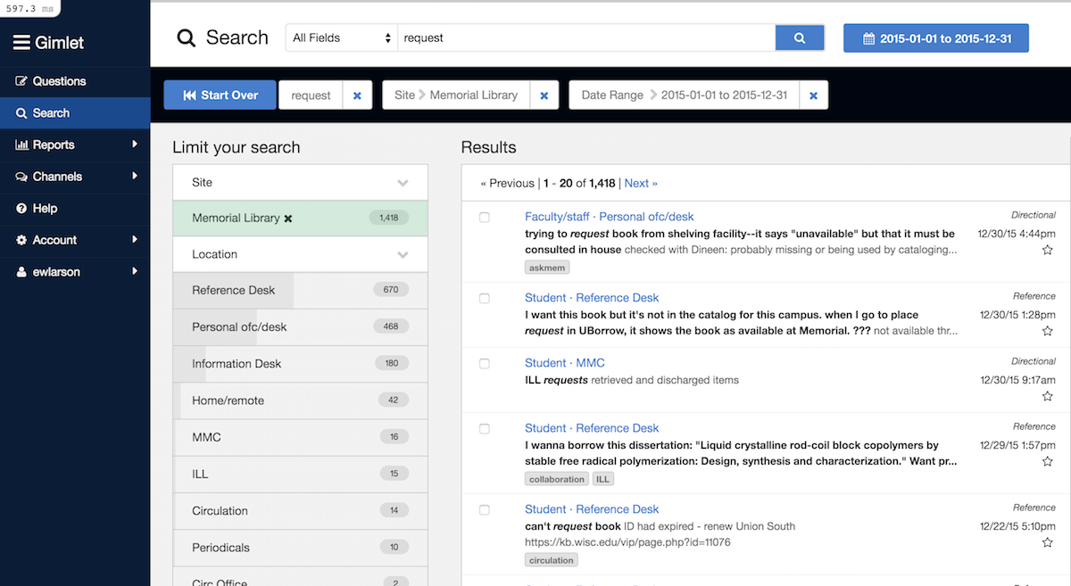
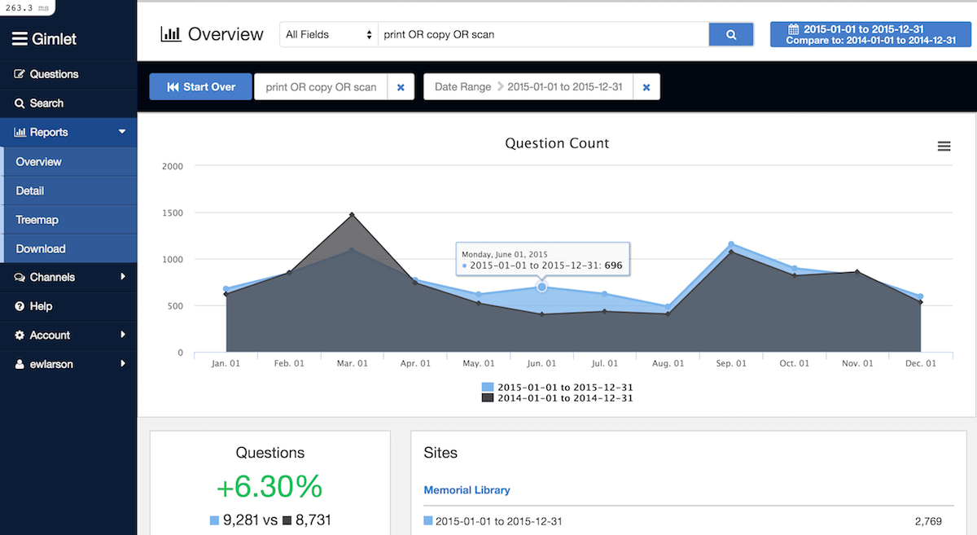
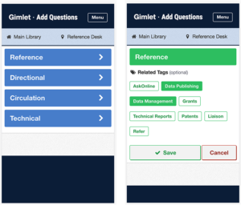
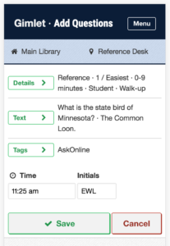
Gimlet - Improvements are coming in next few weeks!
Improved Search -
Facets for limiting your results to particular category values
Full support for complex, nested Boolean queries
Improved phrase and proximity searching
Improved Reports –
New downloadable charts and graphs
Compare data between date ranges
Facet or query directly within reports
Awesome Mobile Support –
Use Gimlet on any device, anywhere.
All the power desktop Gimlet on your phone
Speech-to-text entry on mobile devices
Speed Entry -
Choose a question type
Add tags (optional) & Save!

Slide 18
Thank You For Your Time!
Contact:
  Velappan Velappan M.S., M.L.I.S.,
  Head of Access Services
  Charles W. Chesnutt Library
  Fayetteville State University
  Email: vvelappa@uncfsu.edu
  Phone: 910-672-1236

